Slide 1


Automatic image annotations
Image processing and computer vision
João Rocha e Melo
Javier Navarro
Cristina Luengo

Slide 2
Overview
General pipeline
Watershed
Feature extraction
Classification
Performance measures
Results
Further analysis
Conclusions

Slide 3
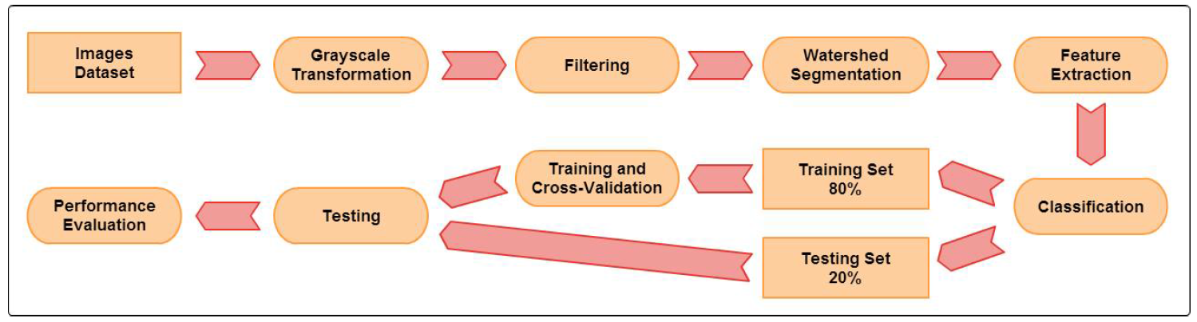
General pipeline

Slide 4
Watershed
L = 0.2989 * R + 0.5870 * G + 0.1140 * B
Gray Scale

Slide 5
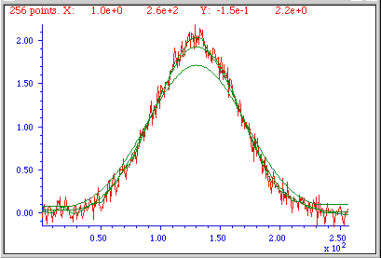
Watershed
Filtering

Slide 6
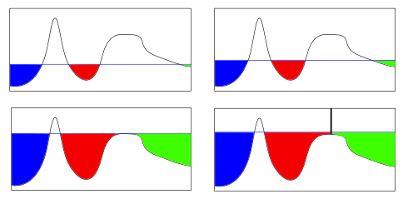
Watershed

Slide 7
Feature extraction: Colour
Decisions taken
RGB – Not imaginary colors
Average RBG of the region
R | G | B
R | G | B
R | G | B
R | G | B
R | G | B
R | G | B
R | G | B
R | G | B
MEAN
R | G | B

Slide 8
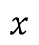
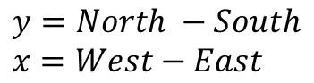
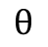
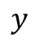
Feature extraction: Gradients
Color Gradient Magnitude
Color Gradient Orientation
Luminosity Gradient Magnitude
Luminosity Gradient Orientation
North
West
PIXEL
East
South
$$y=North −South \\ x=West−East$$
Magnitude
$$y$$
$$θ$$
$$x$$
Orientation

Slide 9
Feature extraction: Number of pixels regions
13 | 13 | 13
13 |  | 15
14 | 14 | 15
13
4 pixels region ID 13
2 pixels region ID 14
2 pixels region ID 15
Pixel
‘without region’
0
Pixel belongs to region ID 13
Region ID’s
Segmented regions from watershed
All pixels with same ID belong to same region
Pixels with region 0 are grouped in other regions
In case of tie is grouped randomly between its neighbors
Why? – Flat areas = bigger regions

Slide 10
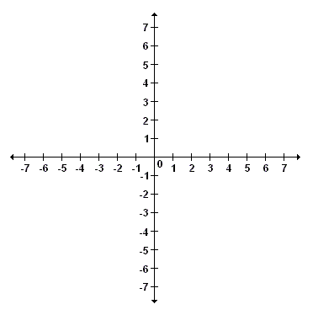
Feature extraction: Positions of regions
P1
P2
P1 (-6, 6)
P2 (4, 4)
P3 (5, -7)
P4 (-4, -3)
Avg
P4
Avg (-1, 0)
P3
Average position of region
Why? – Normally some areas are in the same position in pictures
Sky at the top
Doors, pedestrians at the bottom

Slide 11
Feature extraction: Texture
Local range for each pixel
3 by 3 window to compute output pixel
Output value = Max. Value – Min. Value
Why? – Different texture areas in images (bricks pattern, sky, etc)
3 – 1 = 2
Min. value
1 2 3 4 5
2
1 2 3 4 5
1 2 3 4 5
1 2 3 4 5
Max. value
1 2 3 4 5

Slide 12

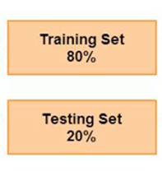

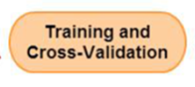
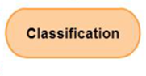
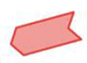
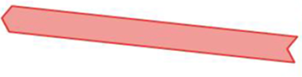
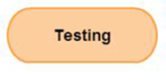

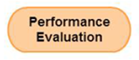
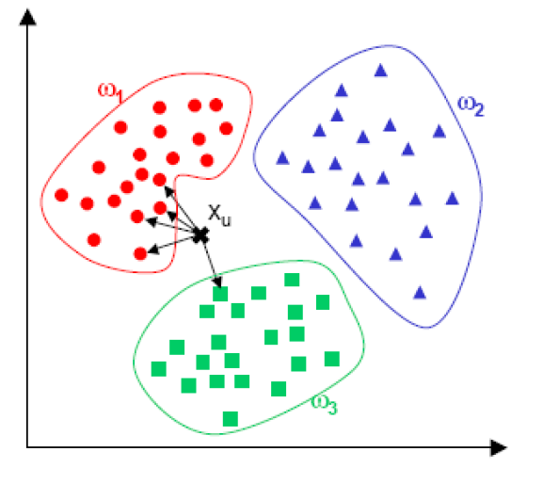
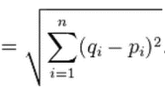
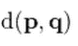
Classification
Weka: Collection of machine learning algorithms for data mining tasks
1. Classifier
2. Number of folds
Parameters
Input
1. K
2. Distance weight
Classifier: K-Nearest Neighbors
Parameters
New instance class = Majority class amongst neighbors
Distance measure = Euclidean distance
Weighted distance = Closer neighbors have more influence

Slide 13
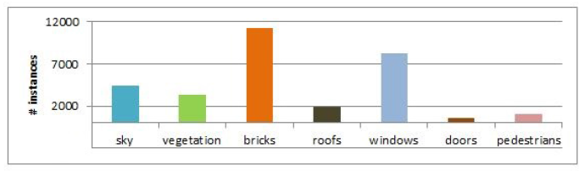
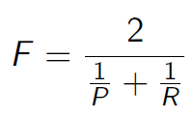
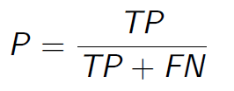
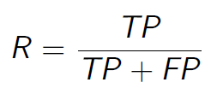
Classification: Performance metrics
Unbalanced dataset
Accuracy is not a reliable measure
AUC: Weka outputs the AUC for each class and the weighted average AUC
For each class, it ranks the probabilities (normalized votes) of each instance and uses the Mann-Whitney-U statistic to compute the AUC, considering the computation for each class a one-against-all problem
F-measure: Harmonic mean of precision and Recall
Confussion matrix: TP, TN, FP, FN

Slide 14
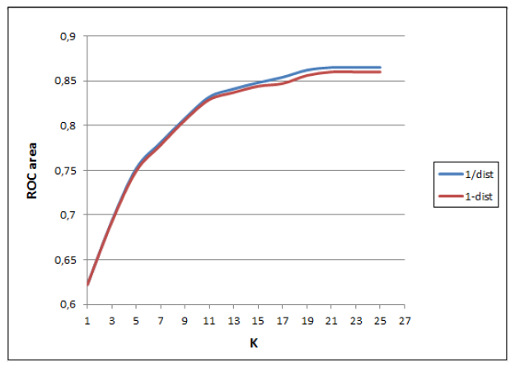
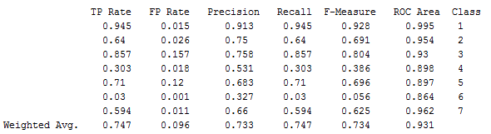
Classification: Train and validation
10 fold cross-validation
Goal: Maximize minimum AUC from all classes
Unbalanced dataset – Weighted average AUC is not reliable
Parameters
K = 21
Distance weight = 1/distance

Slide 15
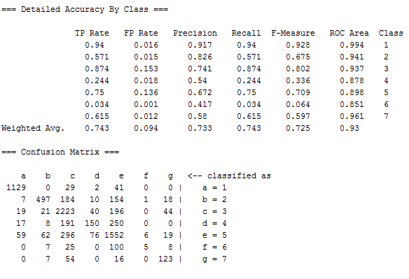
Classification: Test
Using validated parameters
Set of 140 Images (20%)
More than 7500 manual annotated points
Lower performance than in the trainning set
Sky
Vegetation
Bricks
Roofs
Windows
Doors
Pedestrians

Slide 16
Results: Expectations
Sky: Well classified. (Flat area, big region, usually on top position of the image)
Vegetation: High value of gradient and texture. Can be confused as bricks
Bricks: High value of gradient and texture. Can be confused as vegetation
Roofs: Confused as bricks (position)
Windows: Confused as doors (glass) and with everything because of reflections
Doors: Position always on the bottom. Can be confused as windows (glass)
Pedestrians: Hard to classify, very ‘irregular’. High value of gradient and texture

Slide 17
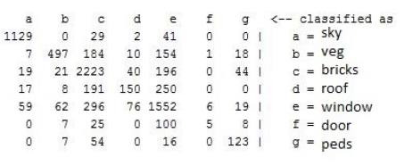
Results
Best classified: Sky
Might reflect the sky or
have a flat surface
Worst classified: Doors.
Mostly confused with windows
Mostly confused with windows and bricks
Can have similar feature values
More windows instances
Windows: Sometimes windows in roofs
Bricks: Similar characteristics
Close in the feature space: Classifier will assign a window label most of the times

Slide 18
Further analysis
Without color:
Features that impacts the most
Smaller impact in the sky
Features like vegetation/bricks/people got mixed up
Without number of pixels in regions:
Most affected class: Pedestrians
Pedestrians were confused with windows due to
their diversity

Slide 19
Further analysis
Without positions of regions:
Most affected class: Pedestrians & Doors
In terms of the other features, these classes have no unique features besides position
Without gradient:
Inconclusive test.
Watershed used gradient, so the only way to understand the gradients impact is to change the segmentation method

Slide 20
Conclusions
Some classes were miss classified
Ways to improve system:
Change segmentation method
Change features – Create more unique features for classes
Change classifier – KNN is sensitive to the amount of data

Slide 21
Thank you
Questions?

